Slide 1

World Food India Hackathon
27 & 28 October 2017, New Delhi
Building Technology Enabled Solutions.
Improving Efficiency. Enabling Growth.

Slide 2
WILDCARDS
Archit Goyal
Mudit Verma
Sagarpreet Chadha
Pradyumn Sinha

Slide 3
REGIONAL CULINARY
INFORMATION
FROM VARIOUS
PARTS OF THE COUNTRY

Slide 4
WHO GETS AFFECTED?
BIG PLAYERS
OF
F&B BUSINESSES
EXPLORERS
&
EXPLOITERS

Slide 5
CHALLENGES
Food is an integral part of our culture!
Regional Food remains Regional :(
SHEER WASTAGE OF I.P. AND TALENT
BRIDGING THE GAP B/W MAKERS AND SEEKERS

Slide 6
CHALLENGES
DIFFICULTY IN ADAPTING TO OTHER REGIONAL TASTES
LACK OF INTERACTION CUTS OFF POTENTIAL BUSINESS OPPORTUNITIES
LACK OF COMMUNITY BASED ANALYTICS

Slide 7
SOLUTION
SOLVING THESE CHALLENGES WARRANTS THAT WE BRIDGE THE GAP BETWEEN THE TWO STAKEHOLDER COMMUNITIES

Slide 8
SOLUTION
AN
OPEN SOURCE
FOOD COMMUNITY
CookHub !
CHAT
TRENDS
SHARING
COOKHUB!

Slide 9
What is it ?
An Open Society where one can freely
Share Recipes
Directly Interact with Recipe Owners
Review Recipes
Look at the trending recipes
Create variations of dishes
Collaborate on various dishes & meals
Analyze and look at the various trends
Get exposed to various business opportunities

Slide 10
The Winnings
Recognition of talent and actualization into monetary value
Toughened Competition in the food market
Regional Food is Global Now.
Opening up of a big space of business opportunities
Data Analytics over Community Behavior is real gold

Slide 11
VALUE PROPOSITION
Diffusion of disjoint food communities into a Single Open Community where we can Analyze , Interact , Share & Collaborate on dishes and recipes to create greater value for all.

Slide 12
Uniqueness
Have you ever heard of an Open Source Food community ?
(Hint : We aren’t talking about food shows & blogs)

Slide 13
App/Site Flow
User
Login
Personal Profile
Trending
Chat
Logout

Slide 14
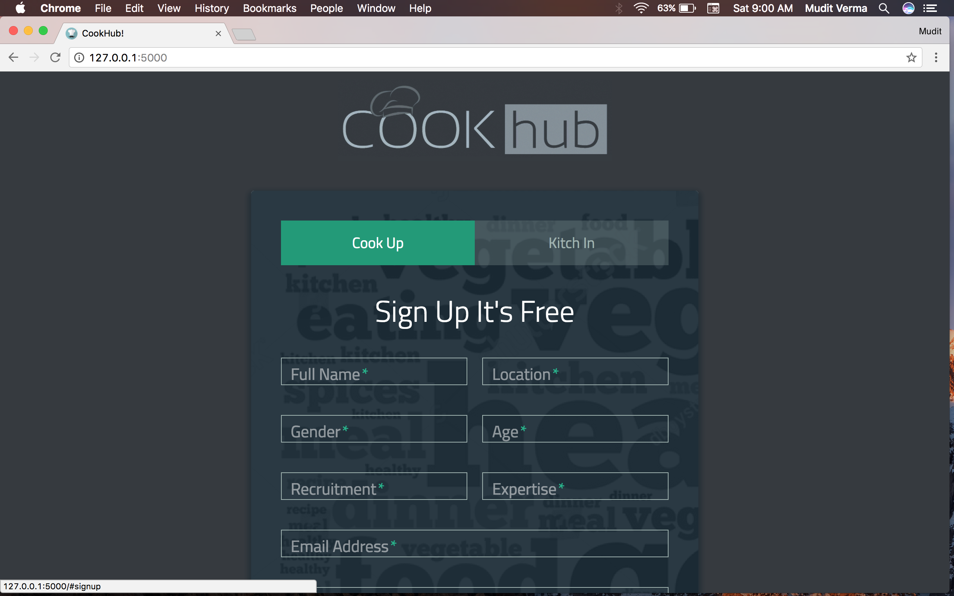

Slide 15
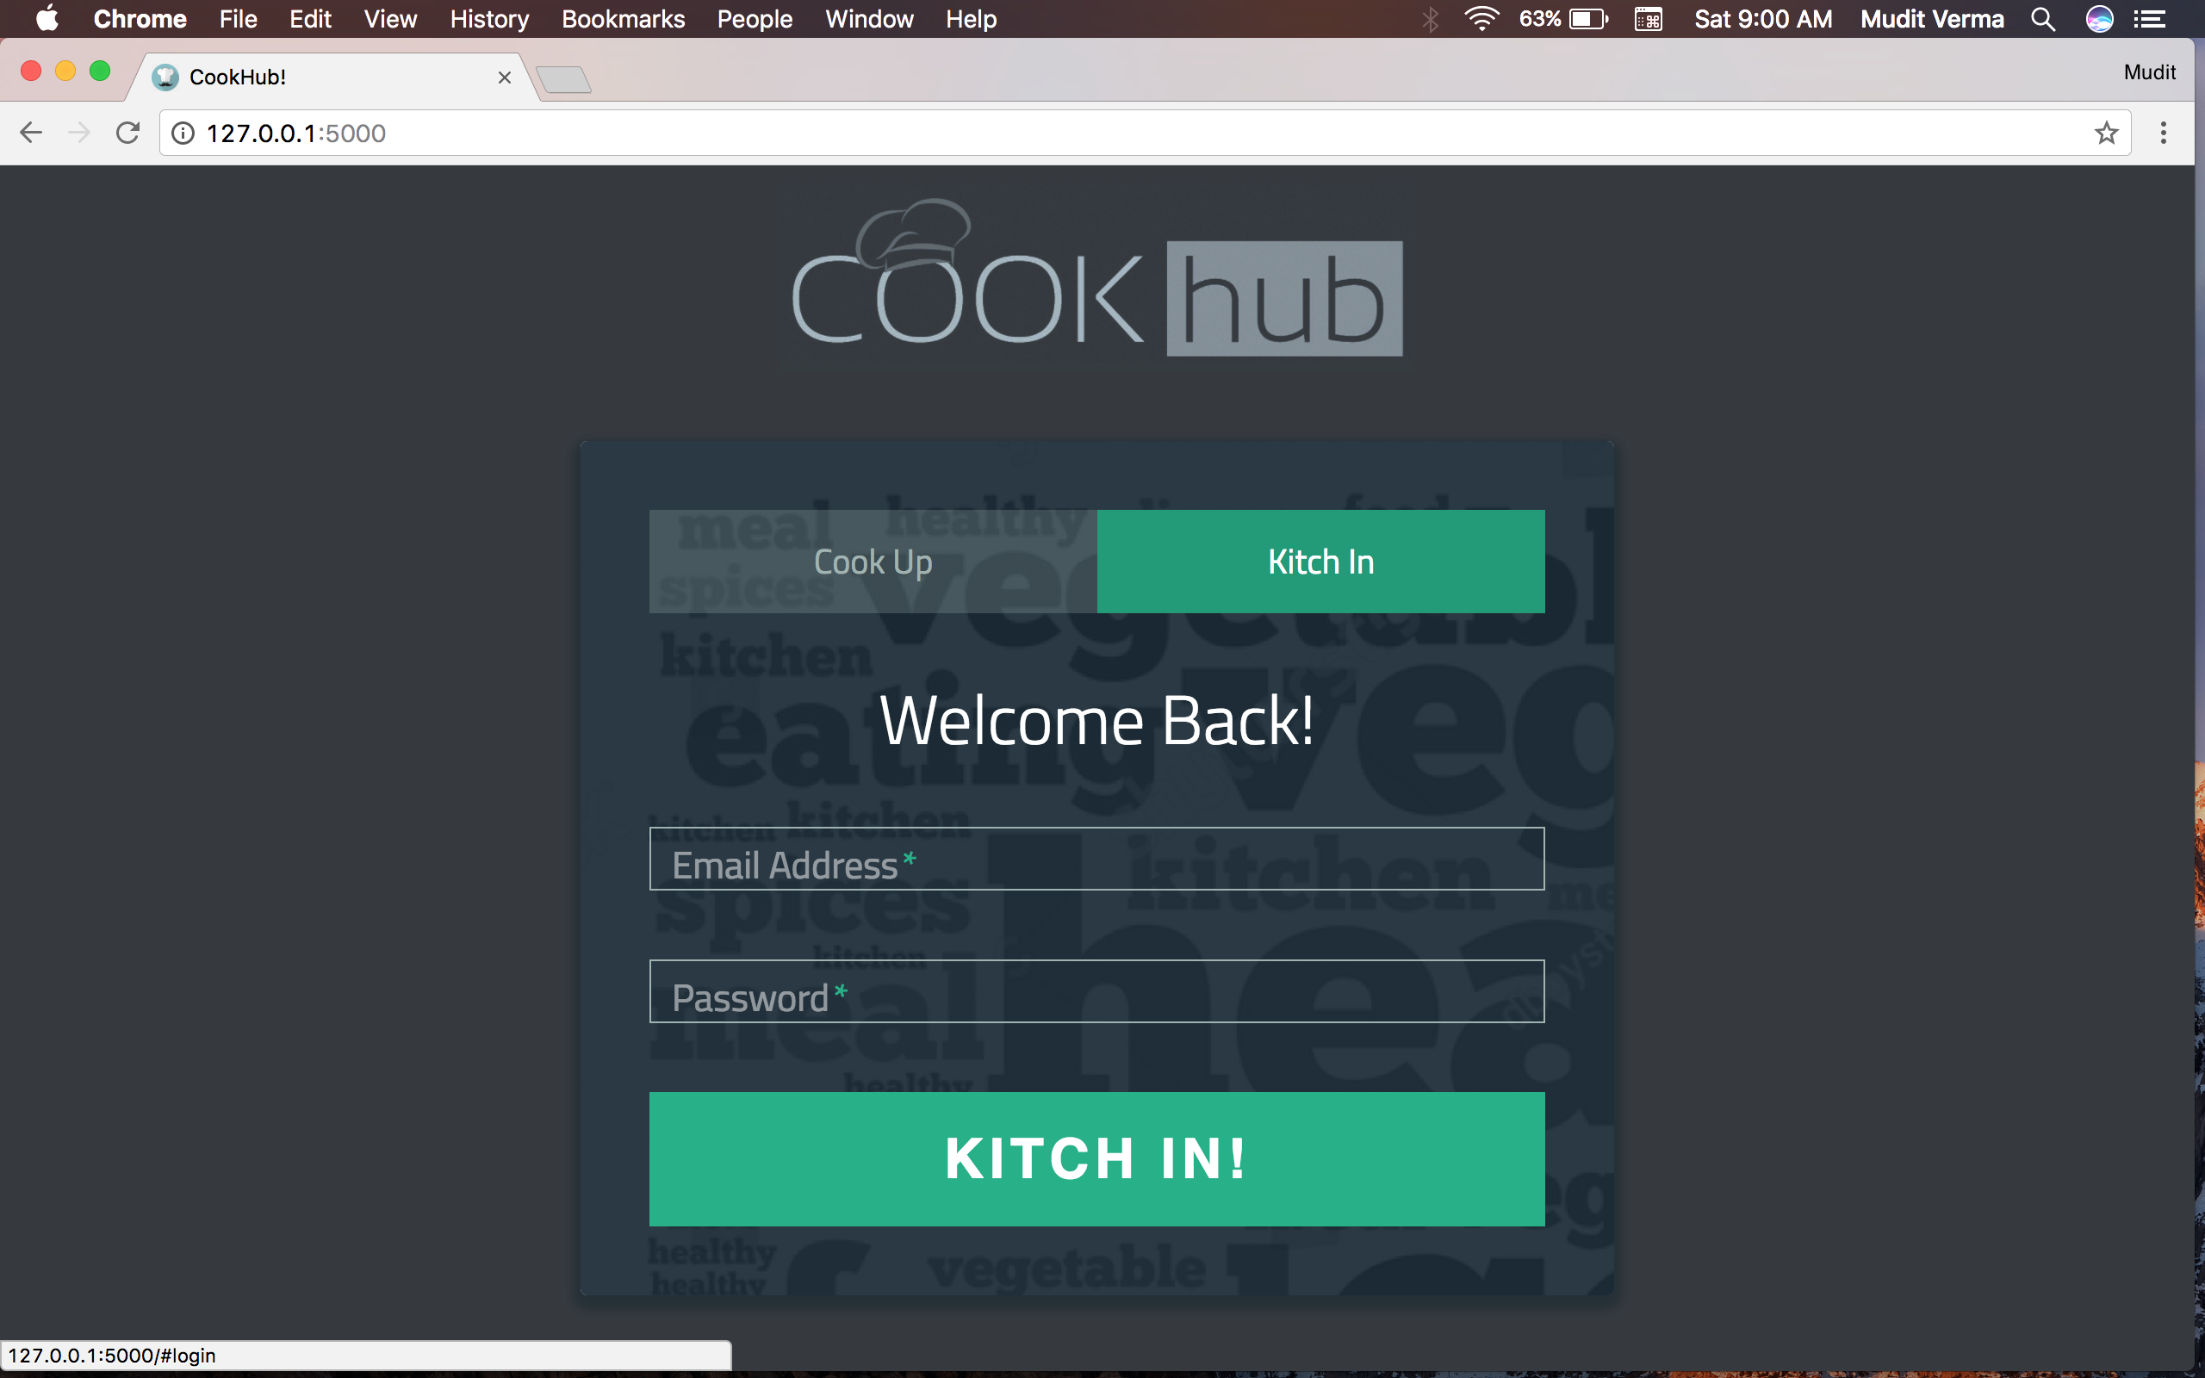

Slide 16
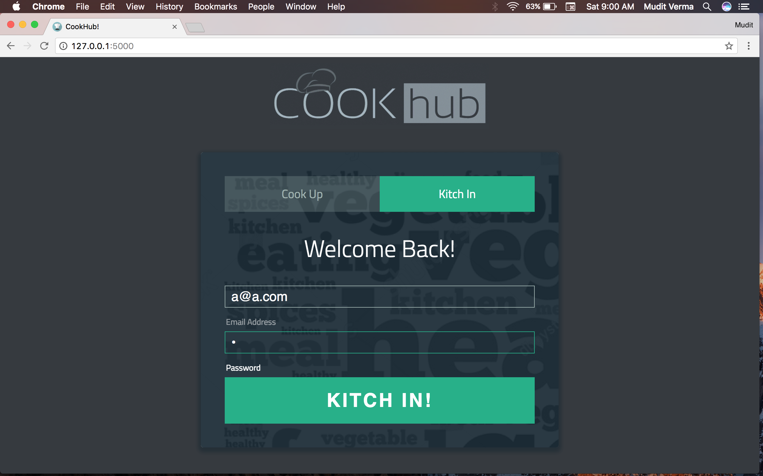

Slide 17
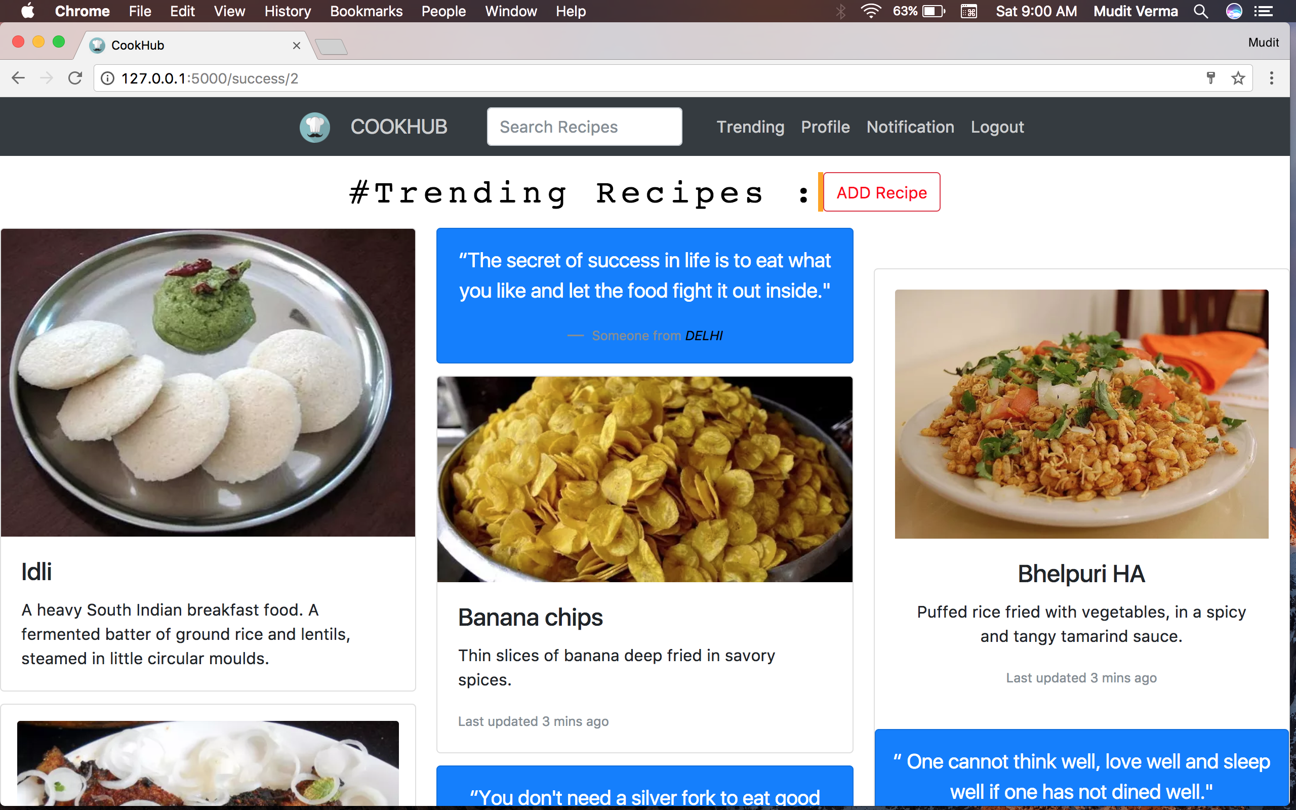

Slide 18
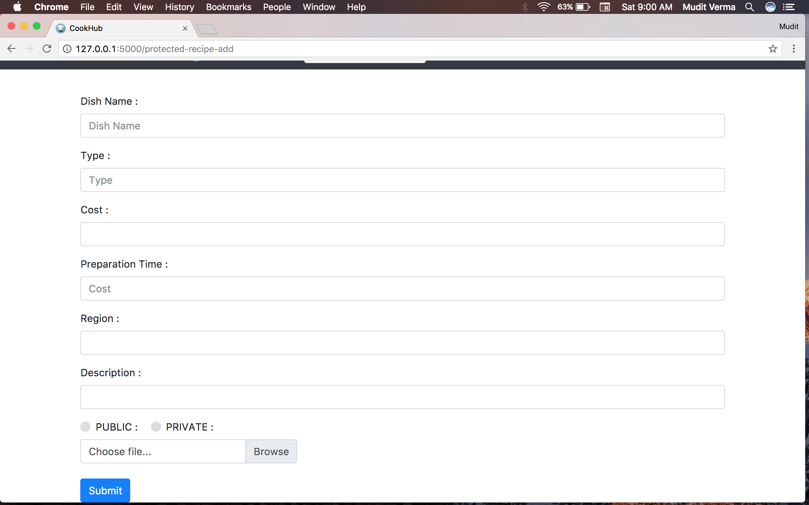

Slide 19
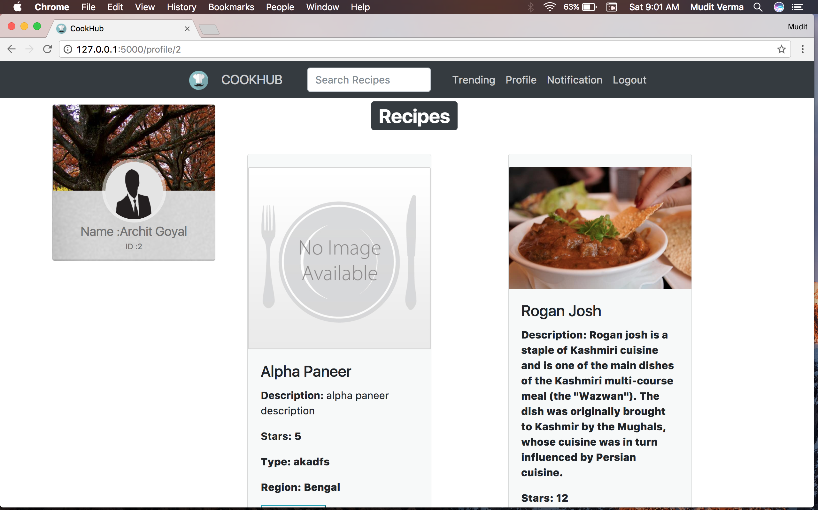

Slide 20
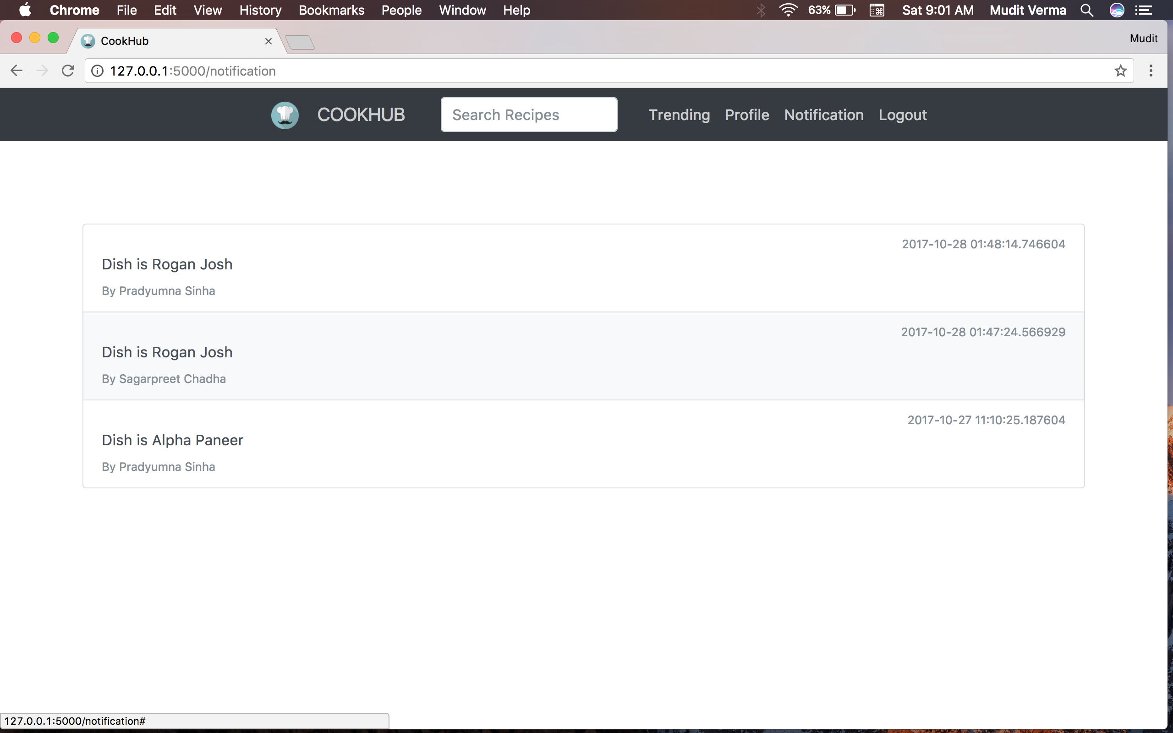

Slide 21
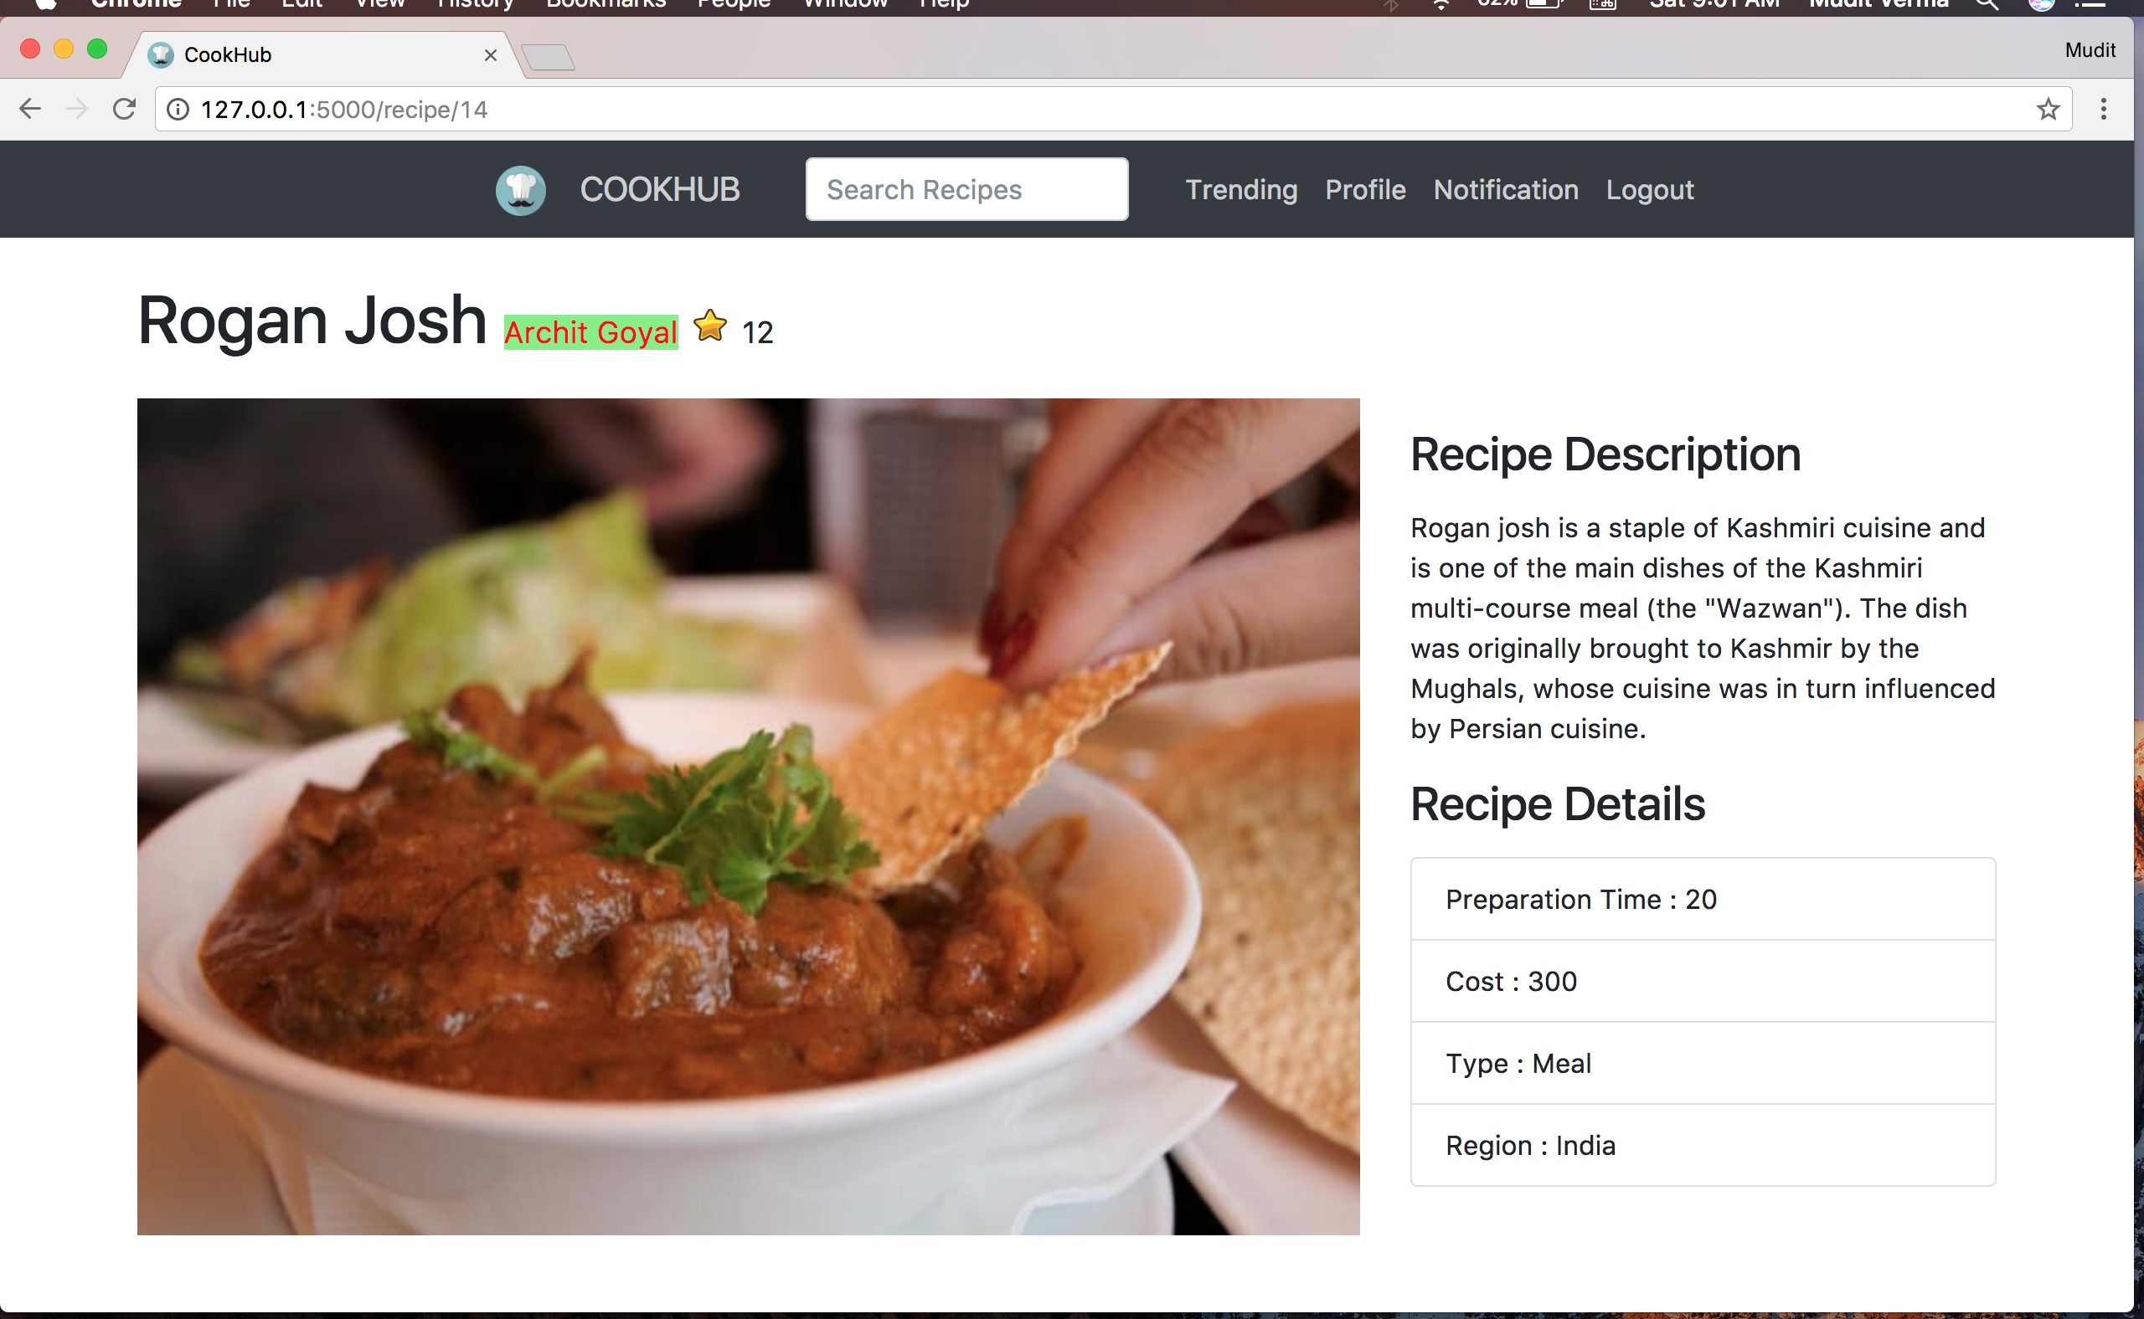

Slide 22
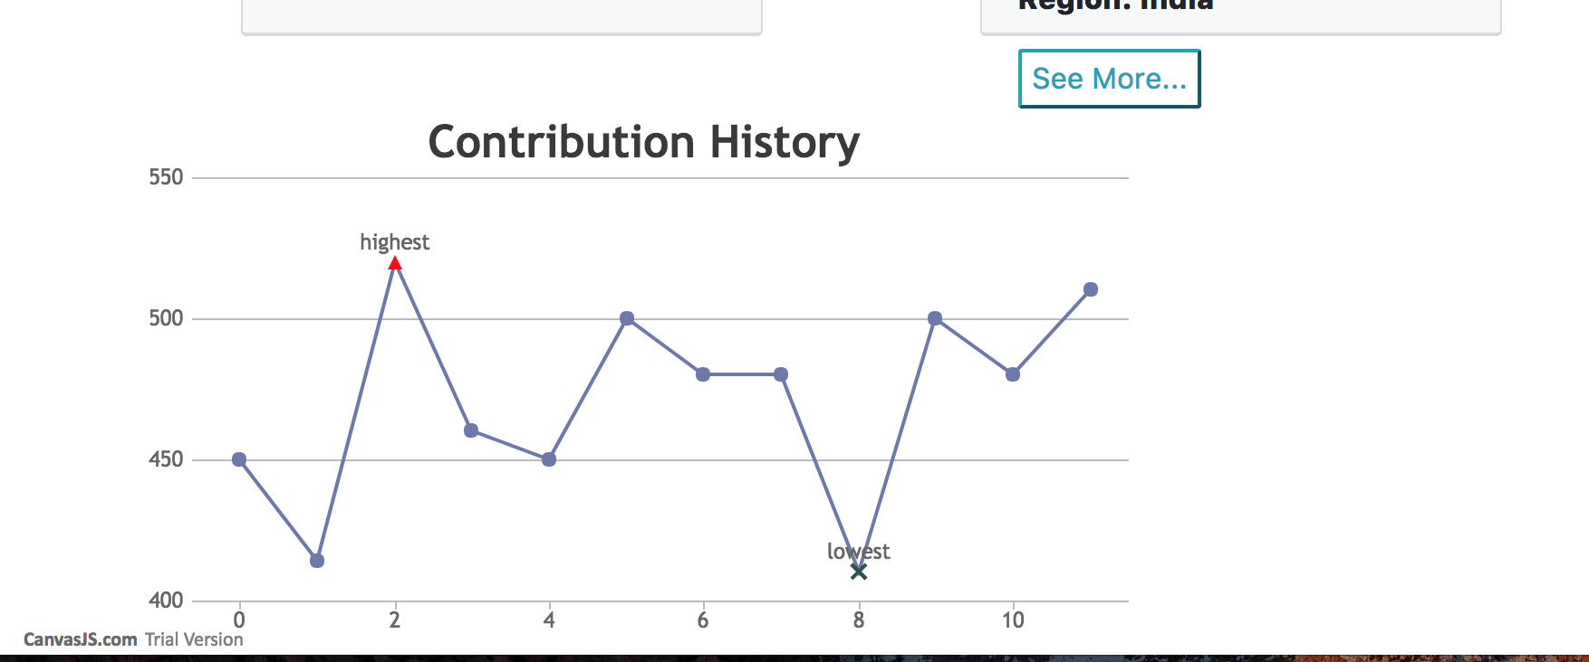

Slide 23
Technology Stack
Flask Web Framework - Backend Architecture
Android Application Platform
Picasso,Volley <- APIS
Firebase for the Chat Architecture
Website Frontend
jQuery,javascript,Bootstrap

Slide 24
BUSINESS MODEL
The solution is not meant to generate profits .Rather , it has a promise to be an economically self-sustaining solution for the the benefit of everyone
WHY IS IT SELF SUSTAINING ?
THE GEMSTONES FOR THE FOOD BUSINESS COMMUNITY
DATA ANALYTICS
OPENING UP OF NUMEROUS BUSINESS OPPORTUNITIES
BETTER CONSUMER – MAKER RELATION

Slide 25
CYCLE OF SELF
SUSTAINANCE
Us
Explorer/Exploiter
F&B Business
Finance
Against for
Analytics & Trends
Ways to Share
Collaborate
Interact
Talent
Recipe

Slide 26
Thanks! - Team Wildcards

